Slide 1
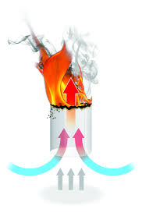
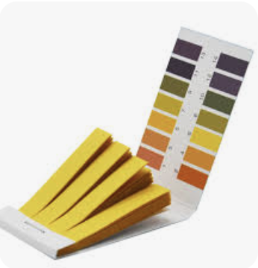
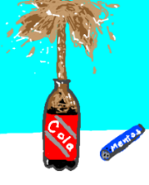
My Science Passport
Name: …………………… Six: .…………………..
Flying teabag
Acid
Test
Compass
Exploding Mentos
Dancing raisins

Slide 2
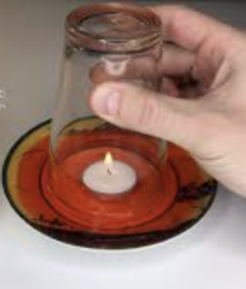
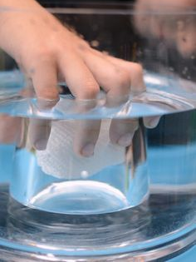
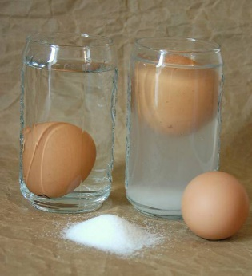
My Science Passport
Lava Lamp
Floating
Candle
Magically Dry Paper
Pulse Rates
Mysterious Floating Egg

